Slide 1
Intent Storing Data on Android
Pemrograman Mobile

Slide 2
Intent

Slide 3
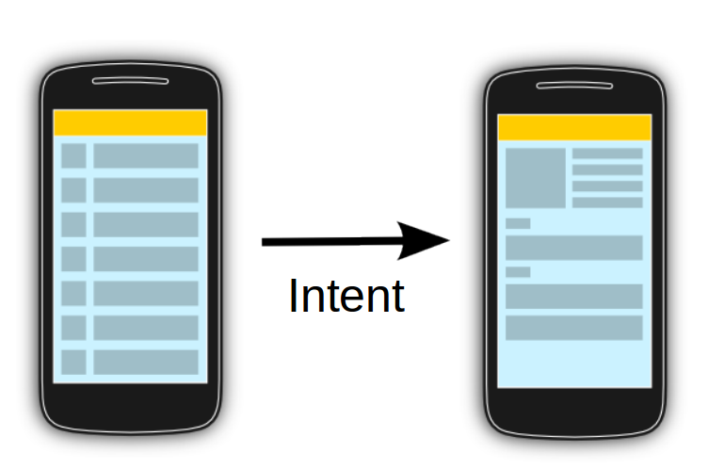
Intent
Allows communication between components
Message passing
Bundle
Activity 1
Activity 2

Slide 4
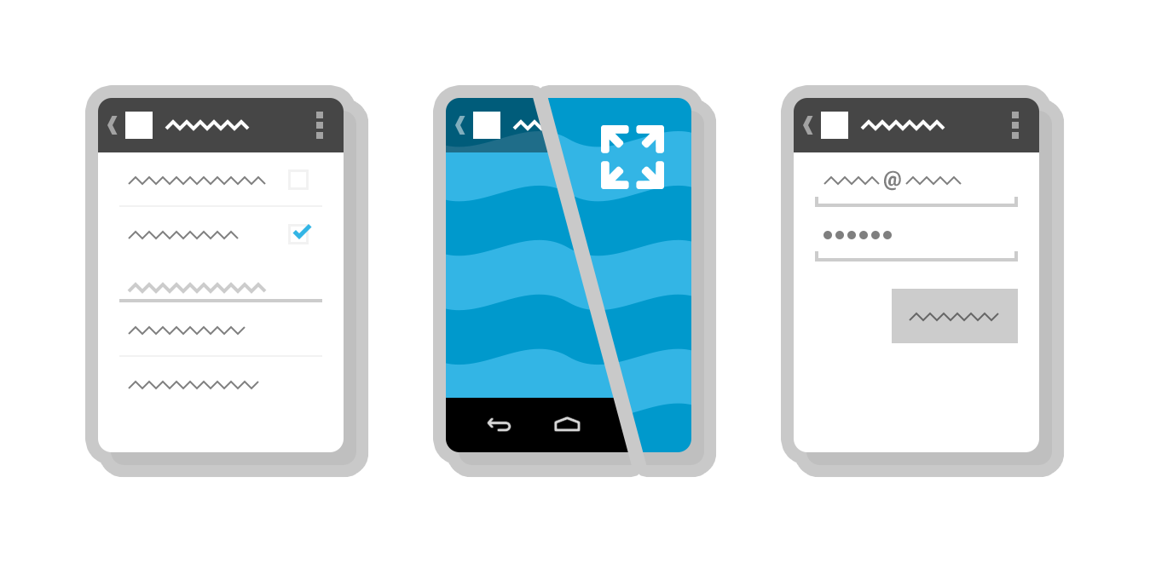
Intent
Three fundamental use-cases of Intent :
To start an activity
startActivity()
startActivityForResult()
To start a service
startService()
bindService()
To deliver a broadcast
sendBroadcast(),
sendOrderedBroadcast(), or
sendStickyBroadcast()

Slide 5
Intent Types

Slide 6
Explicit Intent
Implicit Intent
Intent Types

Slide 7
Explicit Intent

Slide 8
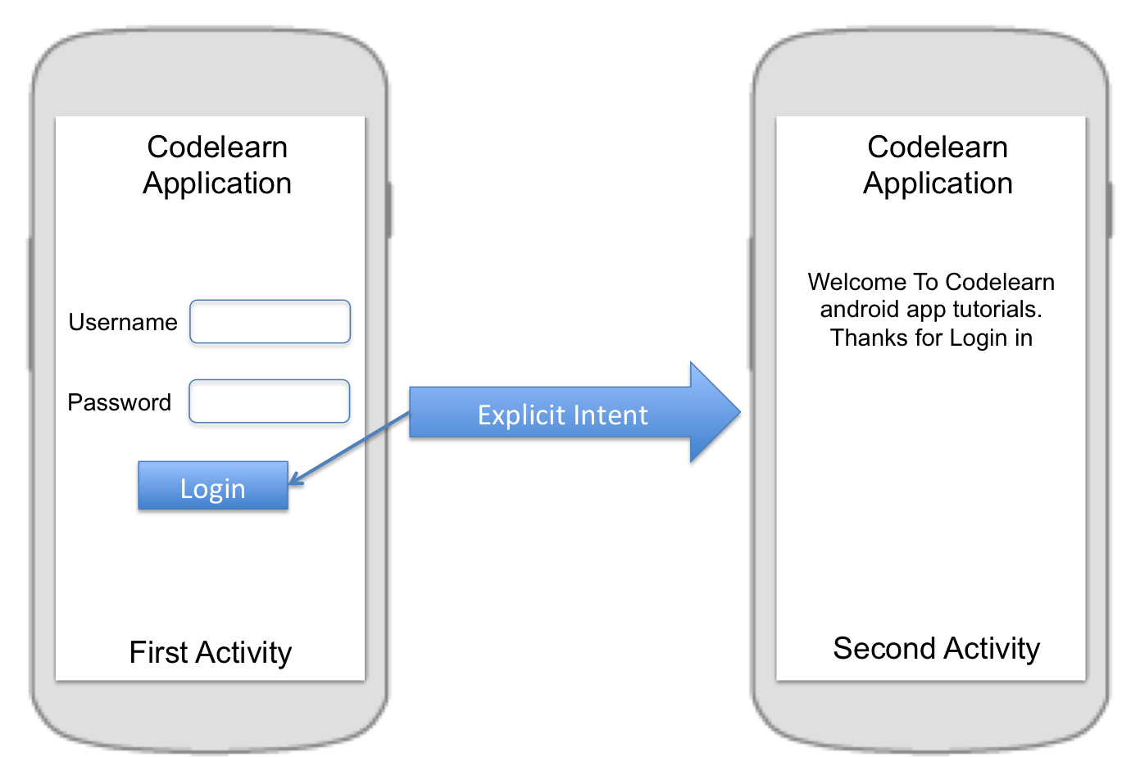
Intent intent = new Intent(FirstActivity.this, SecondActivity.class);
startActivity(intent);
Intent intent = new Intent(FirstActivity.this, SecondActivity.class);
intent.putExtra("Value1", "This value one for ActivityTwo ");
intent.putExtra("Value2", "This value two ActivityTwo");
startActivity(intent);

Slide 9
@Override
public void onCreate(Bundle savedInstanceState) {
super.onCreate(savedInstanceState);
setContentView(R.layout.main);
// Button listener
Button btnStart = (Button) findViewById(R.id.btn_start);
btnStart.setOnClickListener(new View.OnClickListener() {
public void onClick(View view) {
Intent intent =
new Intent(FirstActivity.this, SecondActivity.class);
startActivity(intent);
}
});
}

Slide 10
Implicit Intent

Slide 11
Implicit Intent
This type of intent is called an implicit intent because it does not specify the app component to start, but instead specifies an action and provides some data with which to perform the action.

Slide 12
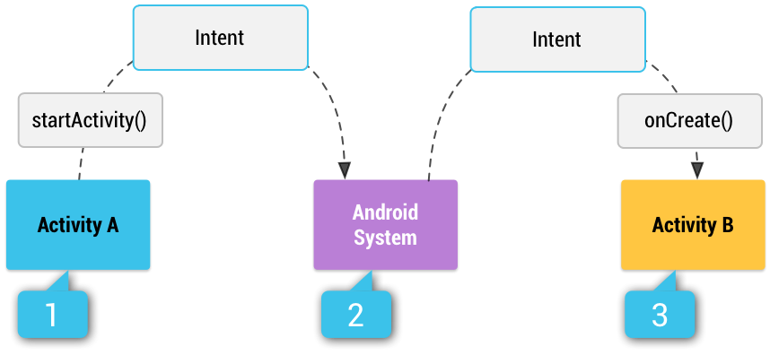
How an implicit intent is delivered through the system to start another activity

Slide 13
Activity A creates an Intent with an action description and passes it to startActivity().
The Android System searches all apps for an intent filter that matches the intent. When a match is found,
the system starts the matching activity (Activity B) by invoking its onCreate() method and passing it the Intent.

Slide 14
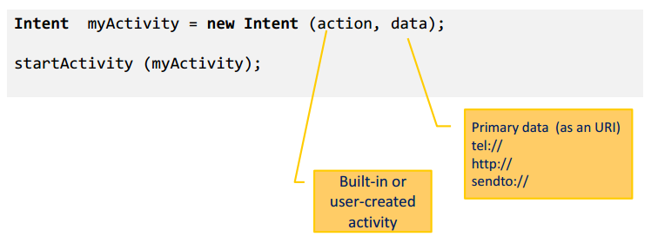
Implicit Intent Structure
The main arguments of an Intent are:
Action : The built-in action to be performed, such as ACTION_VIEW, ACTION_EDIT, ACTION_MAIN, …or user-created-activity
Data : The primary data to operate on, such as a phone number to be called (expressed as a Uri)

Slide 15
Intent Data Example
Action | Data
ACTION_DIAL | tel:081298419869
ACTION_CALL | tel:081298419869
ACTION_VIEW | http://www.diploma.ipb.ac.id
ACTION_VIEW | geo:-6.590056,106.80581499999994 ?z=19
ACTION_EDIT | content://contacts/people/2
ACTION_VIEW | content://contacts/people/
http://developer.android.com/guide/components/intents-common.html

Slide 16







Common Intent
Alarm Clock
Calendar
Camera
Contacts/People App
Email
File Storage
Maps
Music or Video
Phone
Settings
Text Messaging
Web Browser
http://developer.android.com/guide/components/intents-common.html

Slide 17
Manifest Permission
Action | Permission
PHONE CALL | android.permission.CALL_PHONE
ALARM | com.android.alarm.permission.SET_ALARM
INTERNET | android.permission.INTERNET
CALENDAR | android.permission.READ_CALENDAR
CONTACT | android.permission.READ_CONTACTS
CAMERA | android.permission.CAMERA
SMS | android.permission.READ_SMS android.permission.SEND_SMS
http://developer.android.com/reference/android/Manifest.permission.html

Slide 18
Storing Data in Android

Slide 19
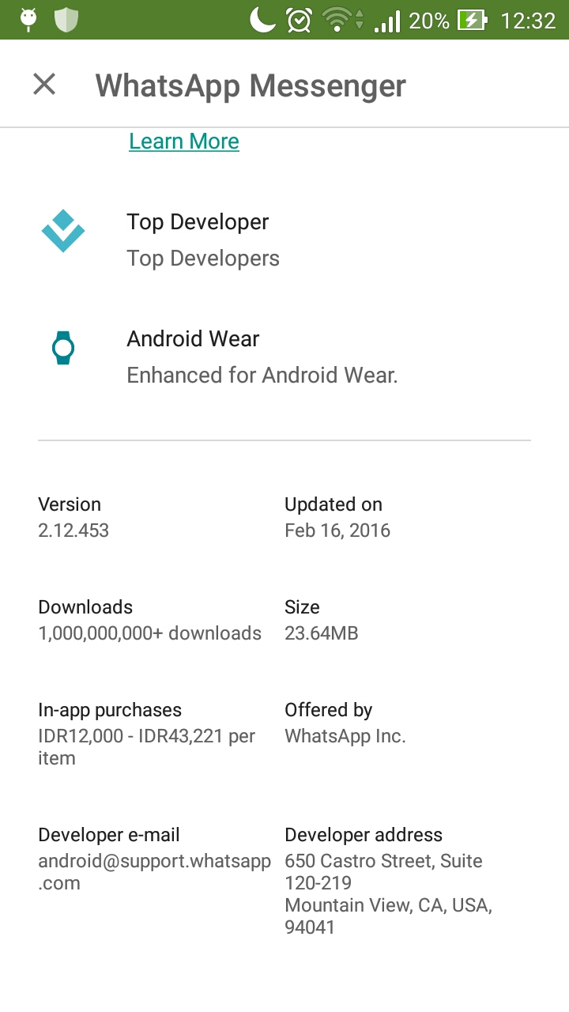


Slide 20
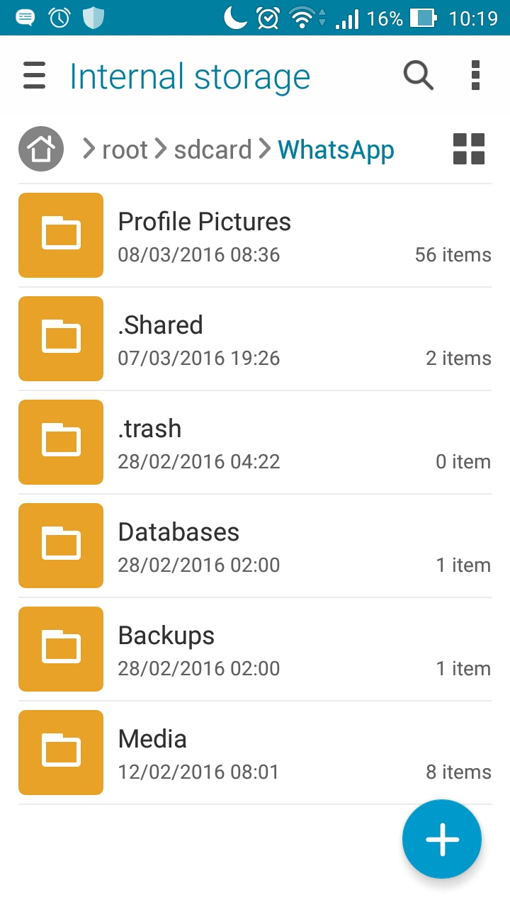
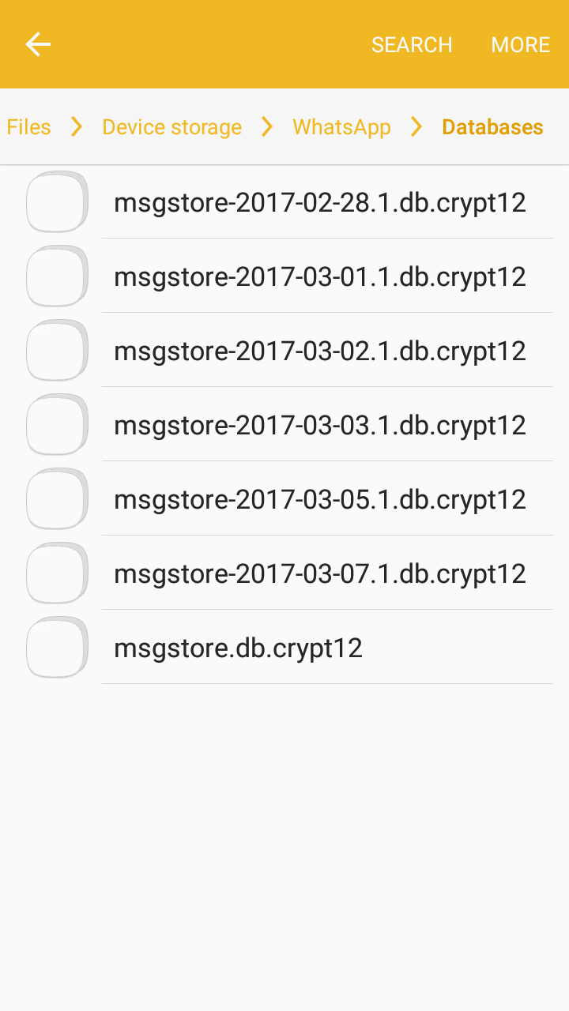

Slide 21
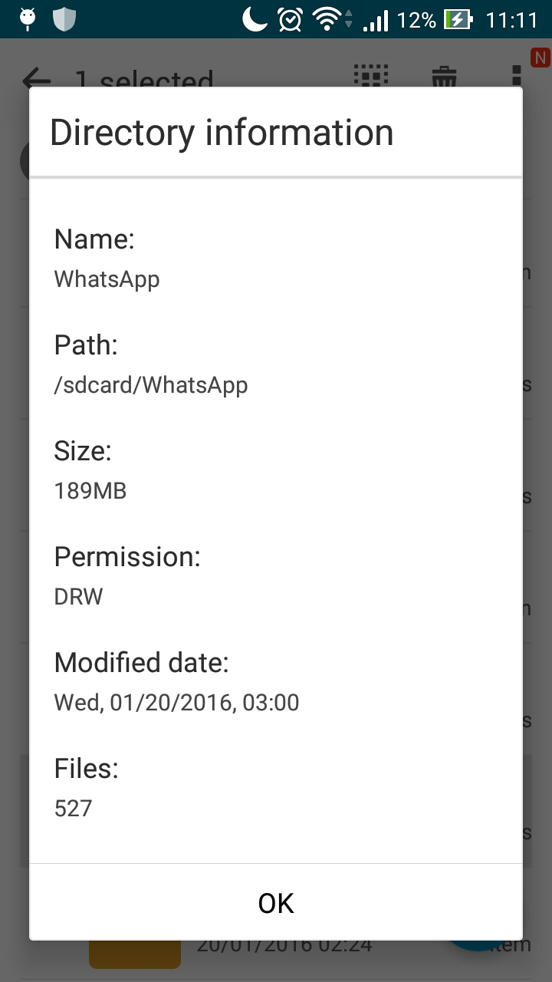

Slide 22
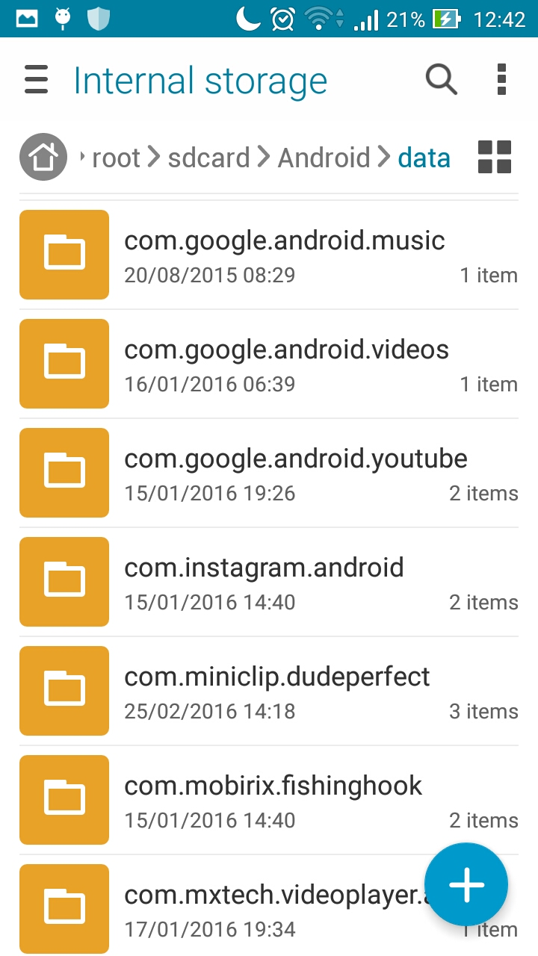


Slide 23
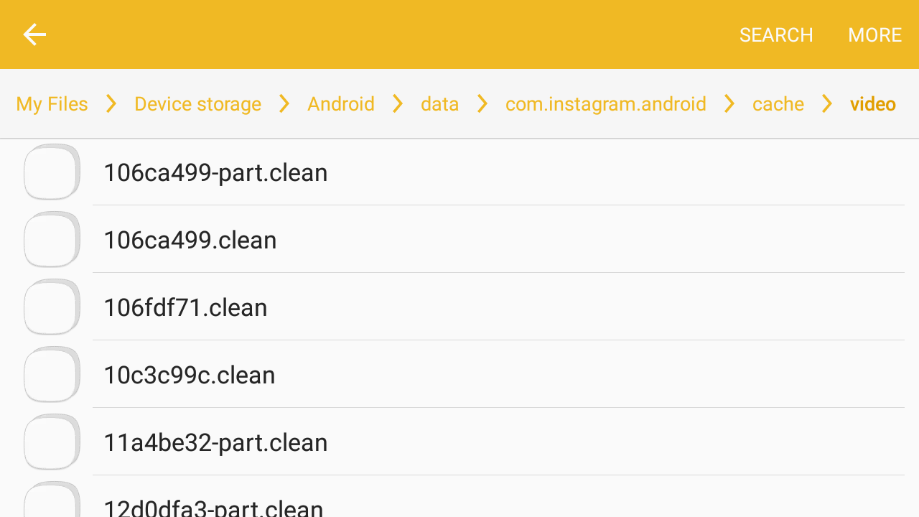

Slide 24
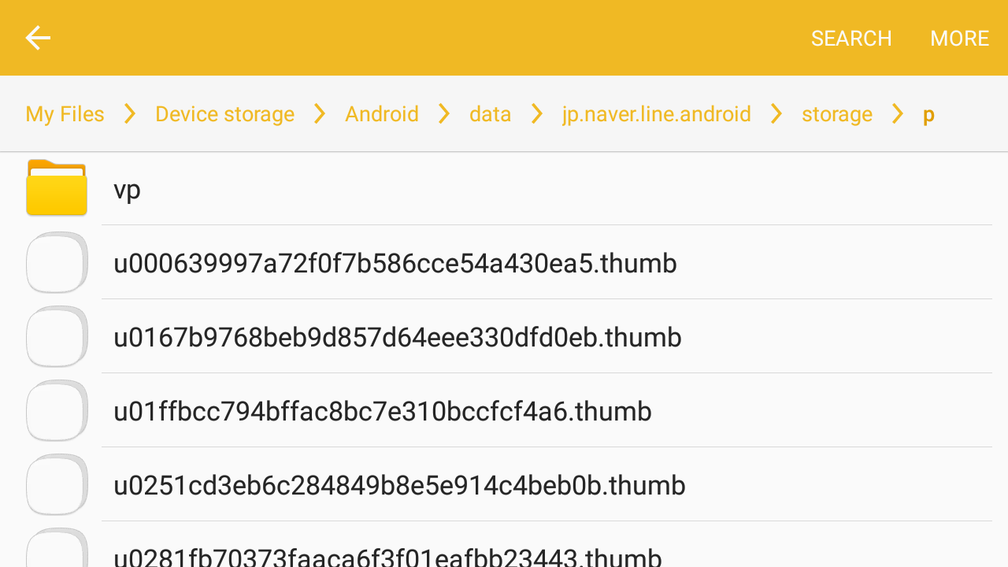


Slide 25
Storage Options
Shared Preferences
Store private primitive data in key-value pairs.
Internal Storage
Store private data on the device memory.
External Storage
Store public data on the shared external storage.
SQLite Databases
Store structured data in a private database.
Network Connection
Store data on the web with your own network server.

Slide 26
Shared Preferences
The SharedPreferences class provides a general framework that allows you to save and retrieve persistent key-value pairs of primitive data types.
booleans, floats, ints, longs, and strings
This data will persist across user sessions (even if your application is killed).

Slide 27
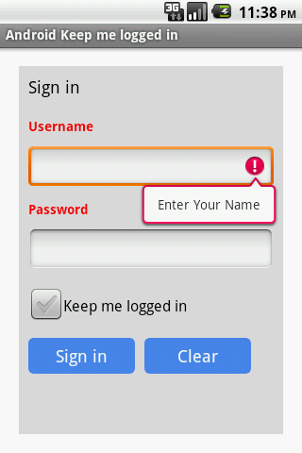
Shared Preferences

Slide 28
Shared Preferences
getSharedPreferences() :
Use this if you need multiple preferences files identified by name, which you specify with the first parameter.
getPreferences()
Using this method you can create Single SharedPreferences.

Slide 29
Shared Preferences
Save Data
// Create object of SharedPreferences. SharedPreferences sharedPref= getSharedPreferences("mypref", 0);
//now get Editor SharedPreferences.Editor editor= sharedPref.edit();
//put your value editor.putString("name", strName);
editor.putString("pwd", strPass);
//commits your edits editor.commit();

Slide 30
Shared Preferences
Retrieve Data
SharedPreferences sharedPref= getSharedPreferences("mypref", 0);
String name = sharedPref.getString("name", "");
String password = sharedPref.getString("pwd", "");
Note : Its store data until you clear data from app or uninstall app.

Slide 31
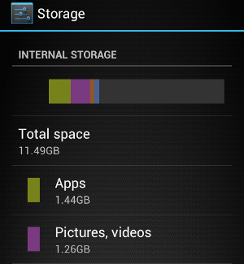
Internal Storage
Internal storage are private to your application and other applications cannot access them (nor can the user).
When the user uninstalls your application, these files are removed.
Saving cache files

Slide 32
MODE_PRIVATE will create the file (or replace a file of the same name) and make it private to your application.
Other modes available are: MODE_APPEND, MODE_WORLD_READABLE, and MODE_WORLD_WRITEABLE.

Slide 33
Internal Storage
To create and write a private file to the internal storage:
String FILENAME = "hello_file"; String text = "hello world!"; FileOutputStream fos = openFileOutput(FILENAME, Context.MODE_PRIVATE);
fos.write(text.getBytes());
fos.close();
MODE_PRIVATE → will create the file (or replace a file of the same name) and make it private to your application

Slide 34
Internal Storage
To read a file from internal storage:
Call openFileInput() and pass it the name of the file to read. This returns a FileInputStream.
Read bytes from the file with read().
Then close the stream with close().

Slide 35
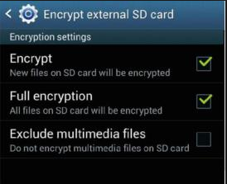
External Storage
External storage such as SD card can also store application data, there's no security enforced upon files you save to the external storage.
All applications can read and write files placed on the external storage and the user can remove them.

Slide 36
External Storage
// add uses permission
<uses-permission android:name="android.permission.WRITE_EXTERNAL_STORAGE" />
// check external storage is available and not read only?
if (!isExternalStorageAvailable() || isExternalStorageReadOnly()) {
saveToExternalStorage.setEnabled(false);
}

Slide 37
SQLite
Android provides full support for SQLite databases.
Any databases you create will be accessible by name to any class in the application, but not outside the application.

Slide 38
Network Connection
You can use the network (when it's available) to store and retrieve data on your own web-based services. To do network operations, use classes in the following packages:
java.net.*
android.net.*

